Slide 1
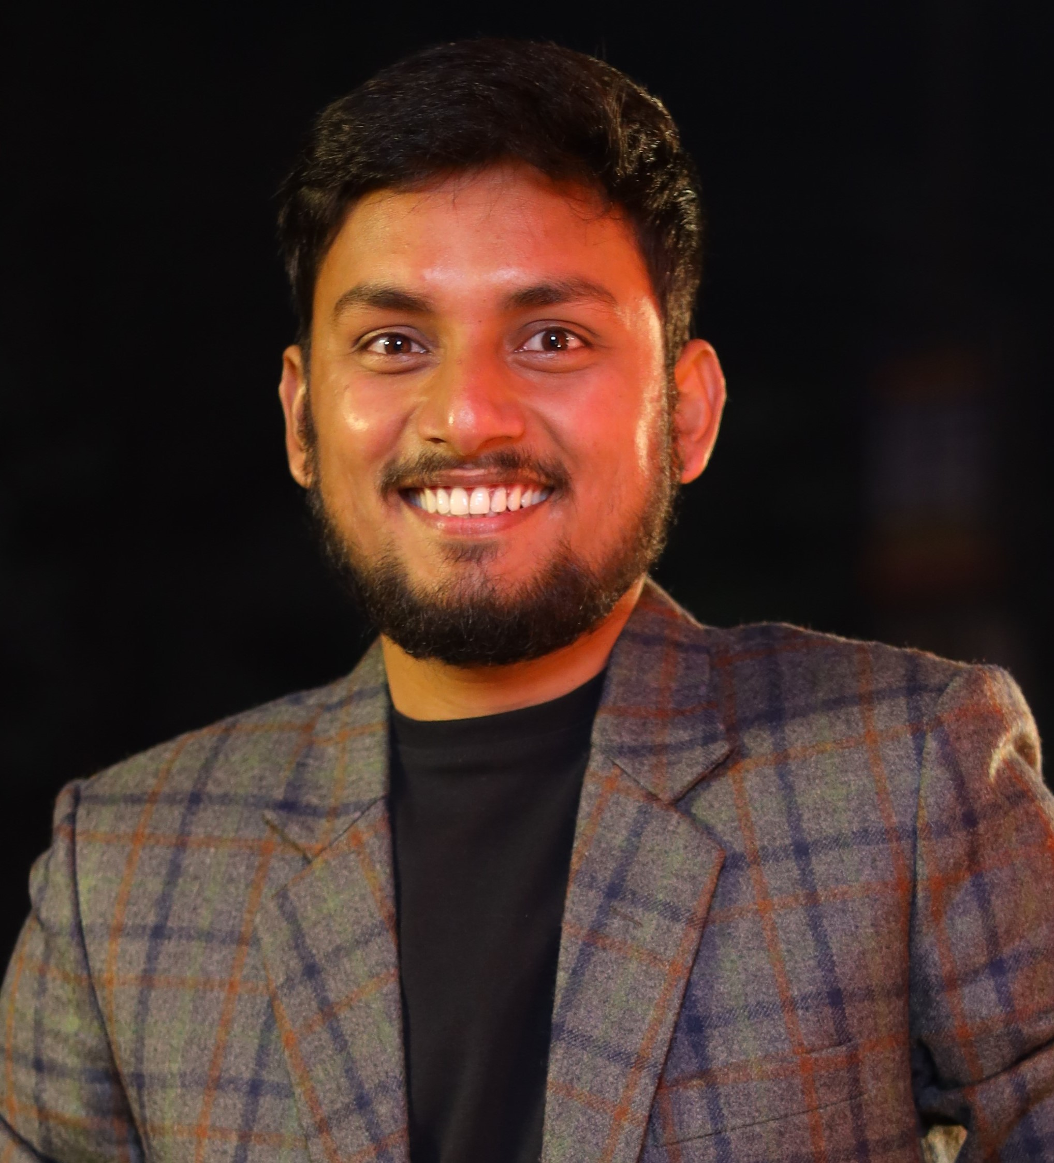
Gourav Kumar Senior Consultant Cloud Architect – Cloud Engineering
Professional Background |  |  | Current / Most Recent Roles
Gourav is a Cloud Architect within Deloitte’s Cloud Engineering practice with a half of decade of experience across Aviation, Telecommunication and . Proven track record of delivering Azure solutions (Build, Design, and Automation) Has hands-on experience in assisting clients achieve 100% infrastructure as code. |  |  | Internal Project – Azure Automation and Process streamlining
 |  |  | Relevant Experience
 |  |  | Oil and Gas – Azure Infrastructure Build Engineer Migrated an oil and gas infrastructure from On prem VDI to Azure WVD Delivered the solution as infrastructure as code (Terraform) Worked on application streaming using MSIX app attach Provided ARM templates to support team to optimise manual errors and increase compliance Telecommunication – Azure Cloud Solution Architect Led the solution design, discovery and migration design for a large-scale on-premise monitoring to Azure using Log Analytics Deployed a number of proof of concepts using infrastructure as code and Azure native tooling Build a custom solution to integrate IBM security tool to Azure Log Analytics British gas distribution company– Cloud Build and Operation Engineer Decision making for creation of Azure infra Written PowerShell Automation scripts, Performed POC, and test cases for them Delivered key cost saving benefits to the client using security best practice along with reserve instances Re-vamped their Azure infra in correct size based on collected metrics data to save cost. Aviation Industry– System & Cloud Engineer Azure operations support Served as a monitoring engineer at times and got exposure on Windows and SCOM
Skills
Microsoft Azure Cloud Office 365 Suite Stakeholder Management Solution Design Requirements Analysis IT and Operations Strategy Infrastructure as Code PowerShell automation Kusto Query Language
Qualifications / Memberships
Azure Certified Architect Design (AZ-301) Azure Certified Architect Technologies (AZ-300) Azure Security Engineer Associate (AZ-500) MCSE in Azure Cloud Platform and Infrastructure (70-533) Azure Virtual Desktop Speciality (AZ-140)
© 2019 Deloitte MCS Limited. Private and confidential.
Notes:
To be updated

